Slide 1
SHOP 24x7
Team 2:
Toheeb Bakare
Sakhan Bhatia
Adbul Basir Abdullah
Nagendra Beesabathuni Surya
Ajith Chowdary Attanti
Trainer:
Bhawna Gunwani

Slide 2
Technologies Used:
NodeJS
ExpressJS
AngularJS
Mongo
Bootstrap

Slide 3
Responsibilities:
Customer
Nagendra
Login (front and backend)
Register (front and backend)
Edit Profile(front and backend)
Toheeb
Homepage, Carousel (front & backend)
Categories Listing, Filter (front & backend)
Products Listing and Details (front & backend)
Abdul
Add to Cart (front & backend)
Checkout (front & backend)
Place Order (front & backend)
Admin
Ajith
Manage products (front & backend)
Profile (front & backend)
NodeMailer (front & backend)
Integration
Sakhan
Manage Users (front & backend)
Display and Manage Orders (front & backend)
AuthGuard and Admin check for routes
UI updates, validations and Integration

Slide 4
Project URL
Project is available for reference at:
Shop 24x7 Project

Slide 5
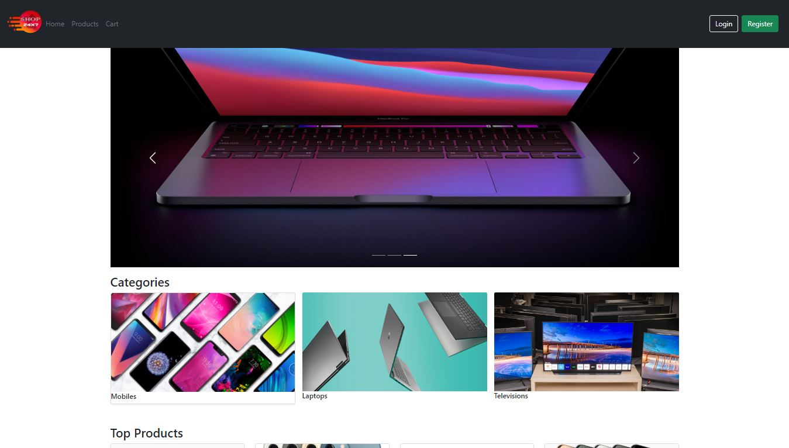
HomePage

Slide 6
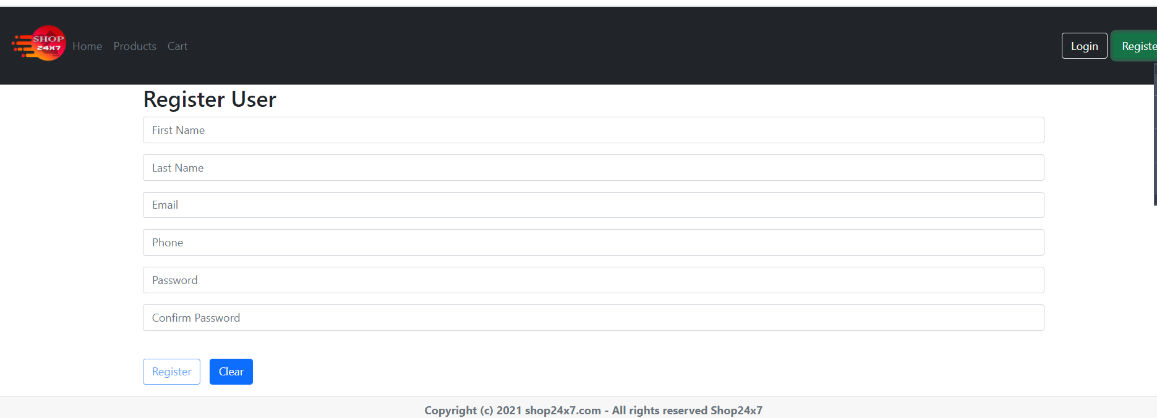
Registration:

Slide 7
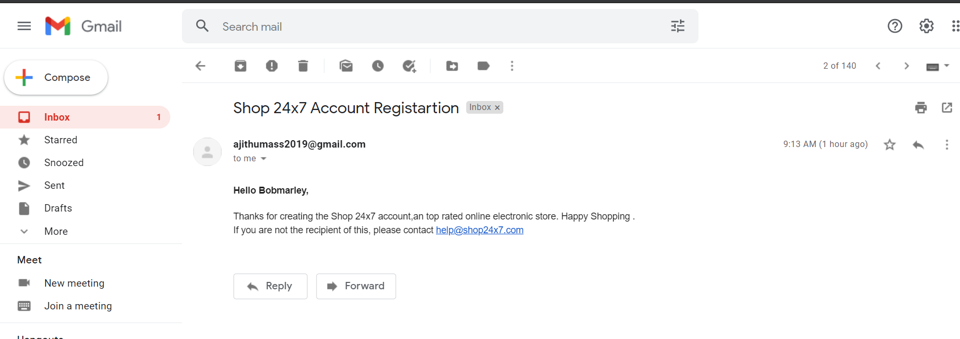
Nodemailer: Email Confirmation After Registration

Slide 8
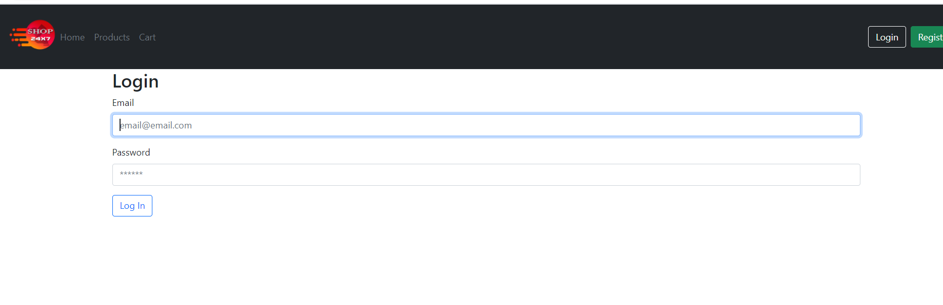
Login:

Slide 9
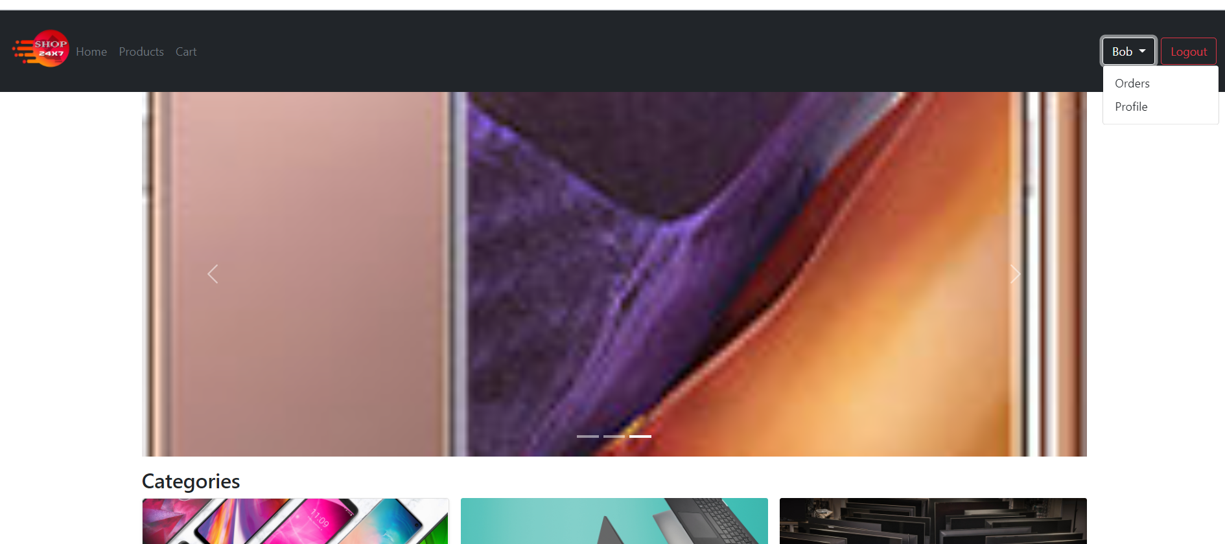
Customer Homepage:

Slide 10
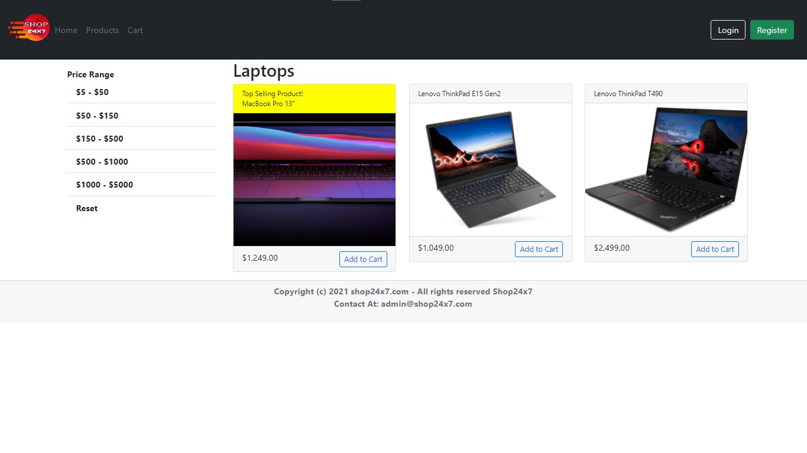
Product: Category
Filtered for price between $1000-$5000

Slide 11
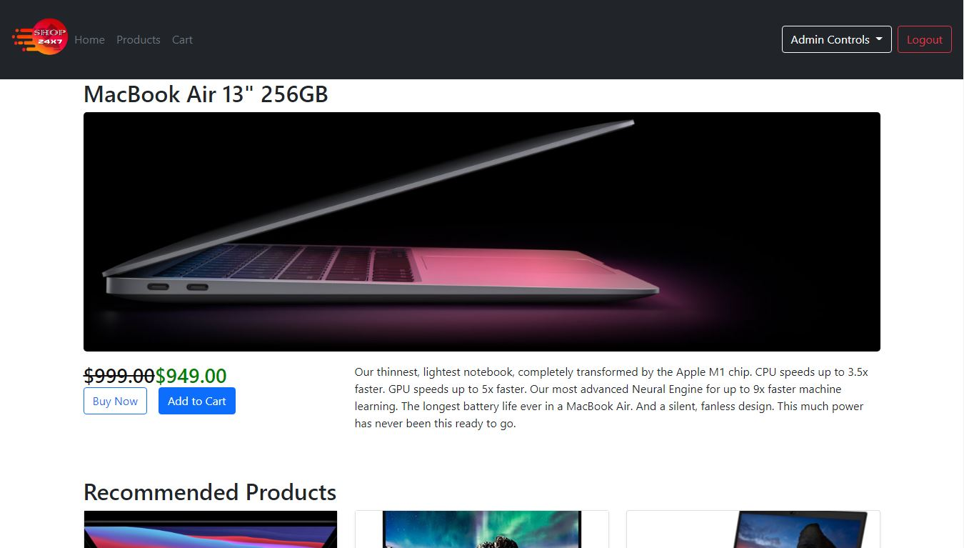
Product: Detail

Slide 12
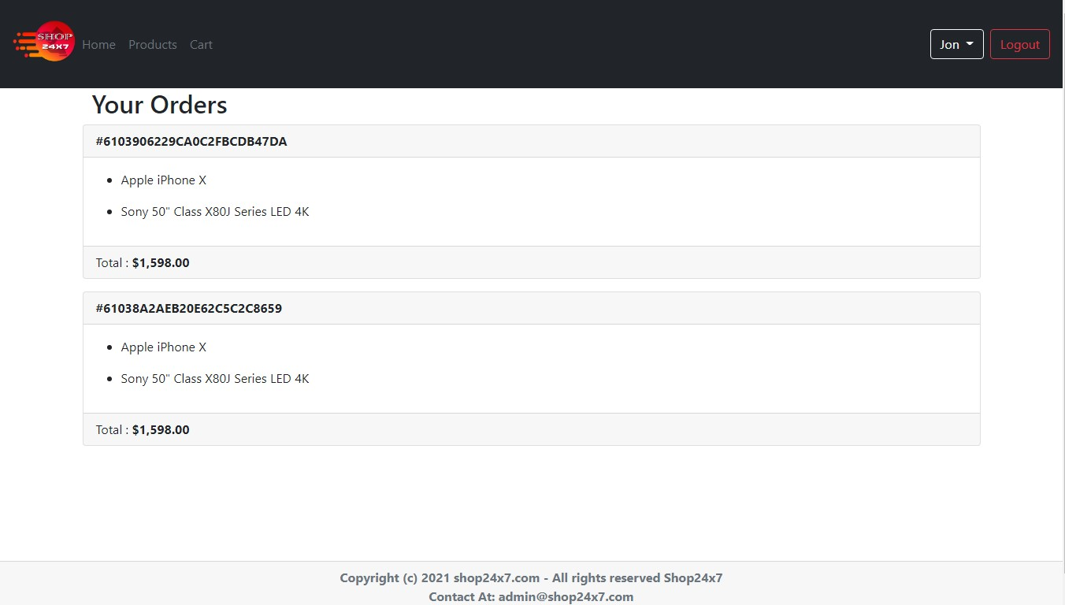
Customer: Orders

Slide 13
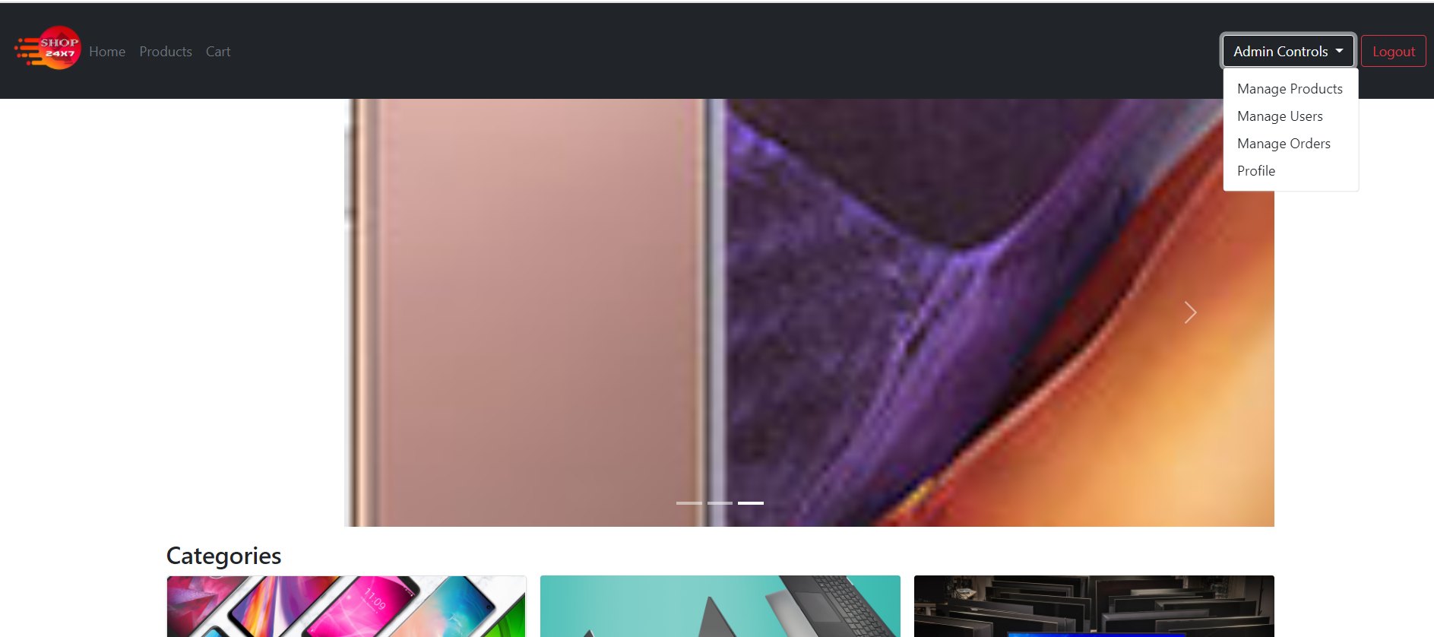
Admin Homepage:

Slide 14
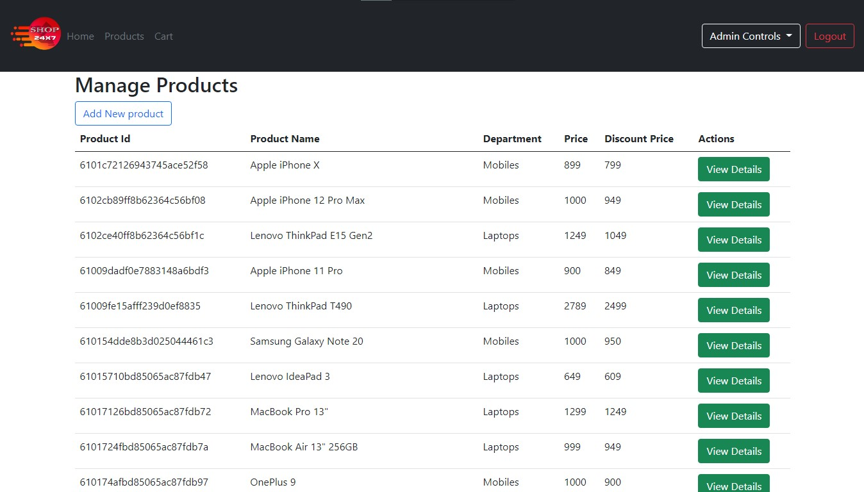
Admin: Manage Products

Slide 15
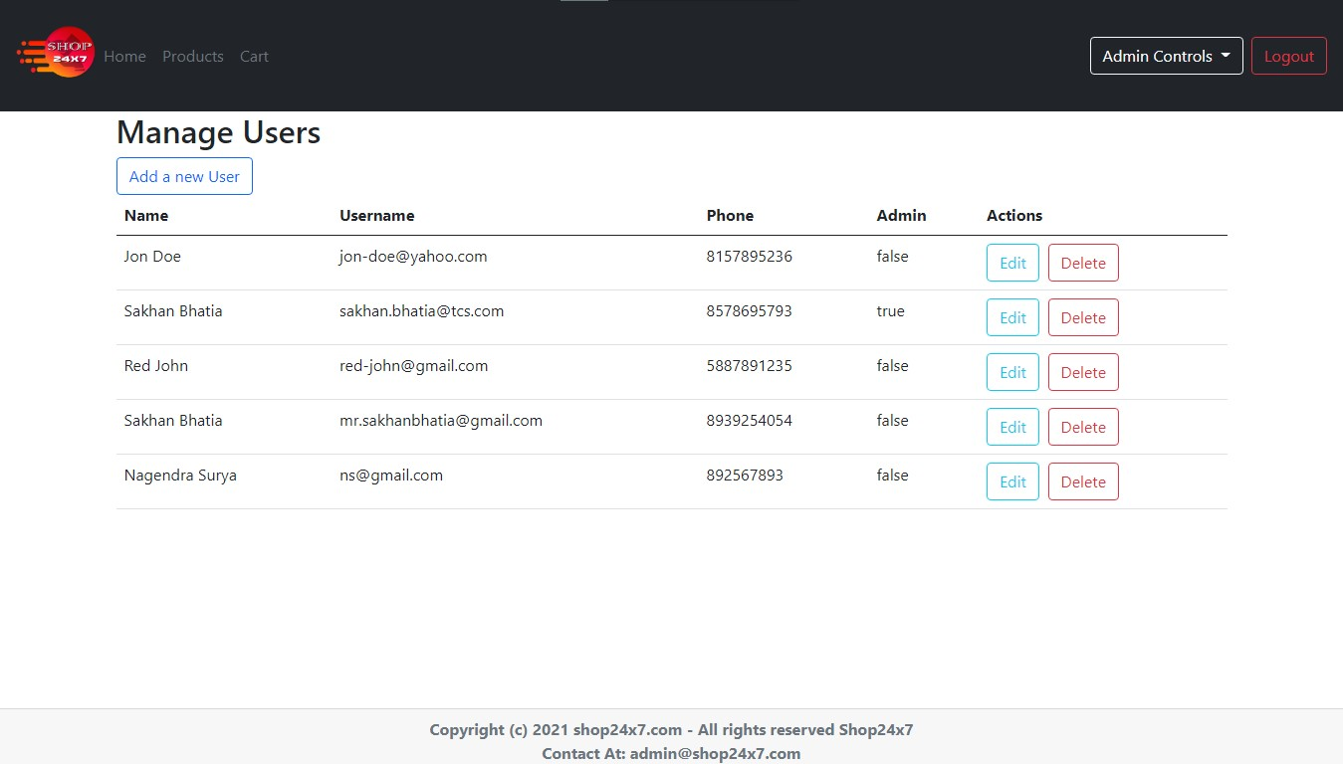
Admin: Manage Users

Slide 16
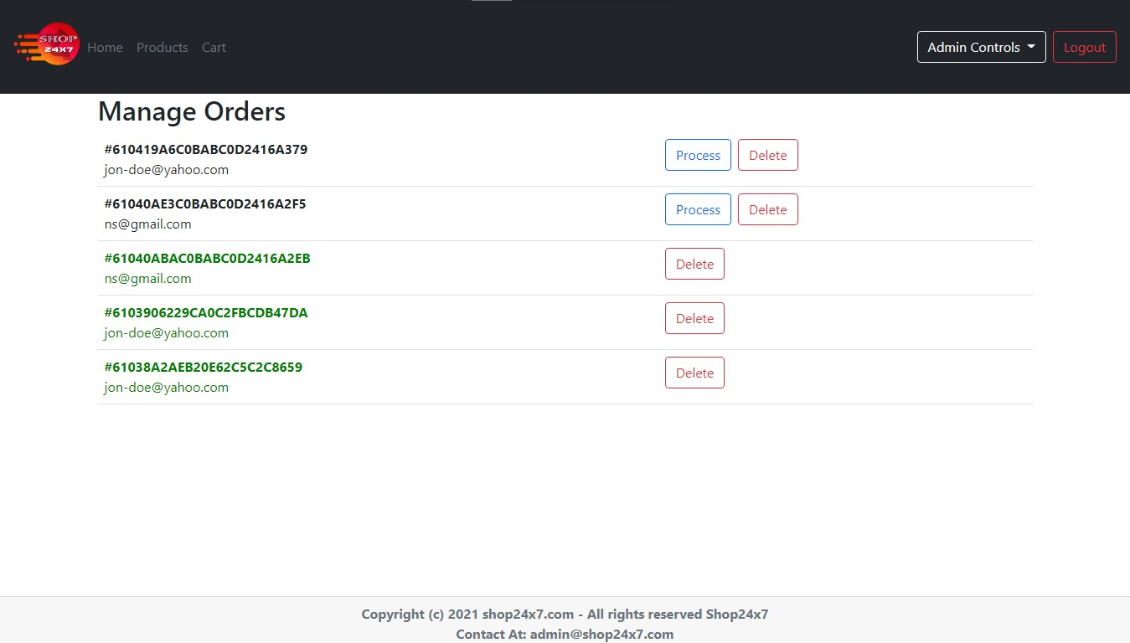
Admin: Manage Orders

Slide 17
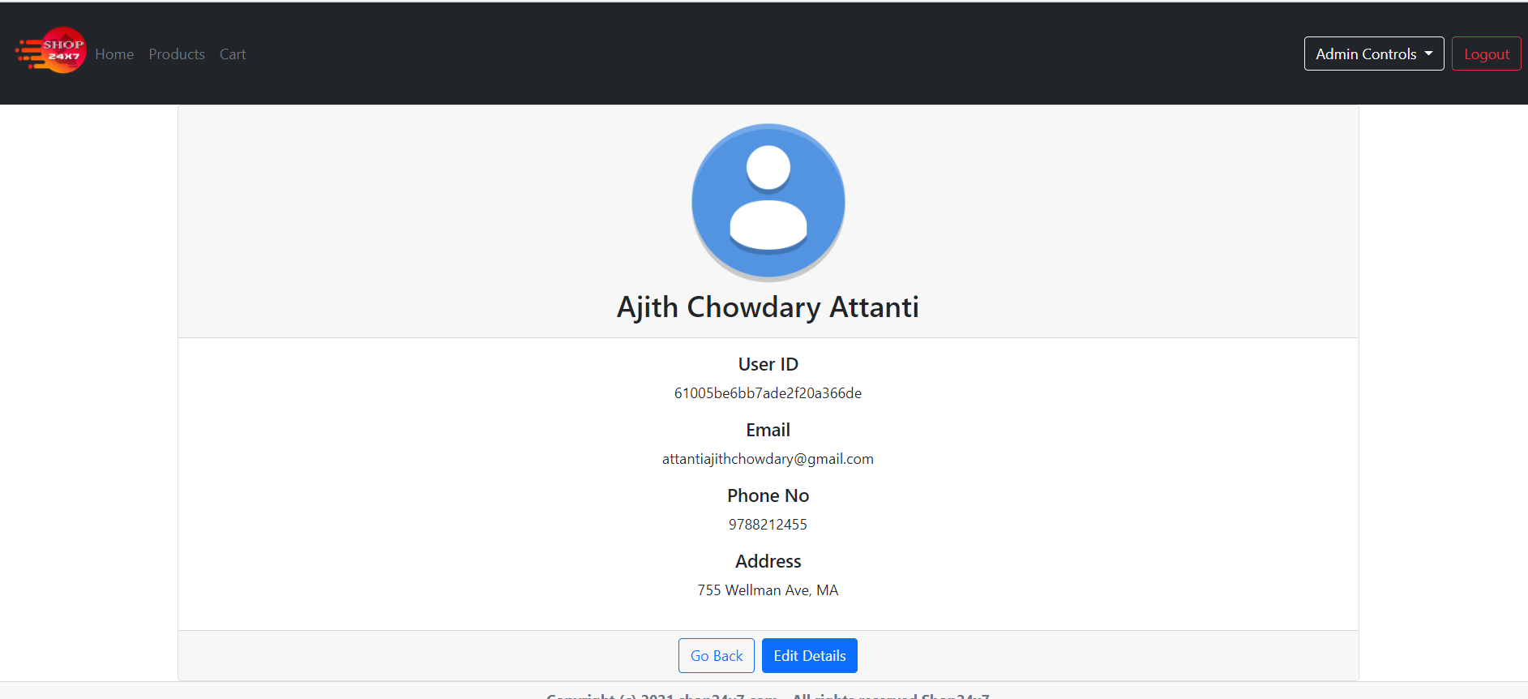
Profile:

Slide 18
Thanks To the Trainer And Team Members

